Slide 1

Modelling Performance at the end of Key Stage 4 (KS4)
School League Tables-Can We simplify?
Traicey Dwyer
12 October 2017

Slide 2

Contents
Introduction
Hypothesis & Problem Statement
Data
Modelling
Initial
Final
Conclusions
Next Steps

Slide 3
Introduction
School league tables were first introduced in 1992 and since then have gone through many iterations using different scoring systems to rank schools.
The question of educational attainment and the factors that affect it is a complex one, studied by many different researchers and official organisations over the years; a quick google search asking the question: what factors contribute to success at school returns 384,000,000 results!
School league tables are used in the UK as a measure of how well schools do in relation to the government base measure of attainment at ages 7, 11, 16 & 18, Key stages (KS) 1, 2,4 & 5. Most lay people look at them as a ranking system for schools with 'better' schools producing a majority of stuents who surpass whatever the measure of success is, be that 5 'good'GCSEs i.e. grade c or above, 3 'good' A levels, ditto, or now, a progress 8 score over 0.

Slide 4
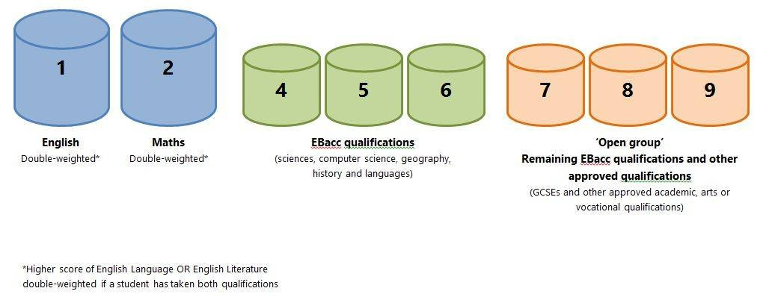
Introduction
Background
In 2013 Progress 8 (P8) introduced across England by the Department for Education
What is progress 8? National z scoring system of exam results.
(z score, standardised scoring based on mean)
The P8 score is made up of the following components:
Issues:
Fairness: P8 taken across All students regardless of background.
Value Added by School: is there a simple way to present/measure this?
Notes:
My main concerns are:
will it be possible to model the impact of advantage/disadvantage without many other explanatory variables?
It seems to be agreed that educational attainment depends on many factors a key one being advantage/disadvantage Rasbach et al as cited in [1]
Time, will I have enough time to develop a model? having too much data can be as big an issue as having too little;
size of data: there is a lot of data which will need to be processed;
Not being an expert validating the model may be a problem;
As Progress 8 is a new methodology it would be useful to model an historical year's data in the same way as progress 8 to test any modelling and see what the differences are. This is beyond the scope of this project but would be a required step if the project were to be expanded;

Slide 5
Hypothesis
Alternative Hypothesis
A pupil receiving free school meals, an indicator of 'disadvantage’, chances of reaching the KS4 benchmark will be affected by factors including the intake profile of their school.
Null Hypothesis
A pupil receiving free school meals, an indicator of 'disadvantage', is just as likely as a pupil not receiving free school meals to achieve the KS4 benchmark.
Project Aim: to group public schools by educational attainment at KS2 and form a model that predicts the outcomes for progress 8 at KS4. Private or Independent schools will not be included in this analysis.
Notes:
Model: The outcome of this model will be a probability of a pupil attaining the required level of progress based on their KS2 attainment upon entry to the school in question. One of the key factors for pupil attainment appears to be whether they are advantaged/disadvantaged as well as the attainment achieved at KS2. This is a categorical problem, which would at first glance appears to favour a logistic regression approach.

Slide 6
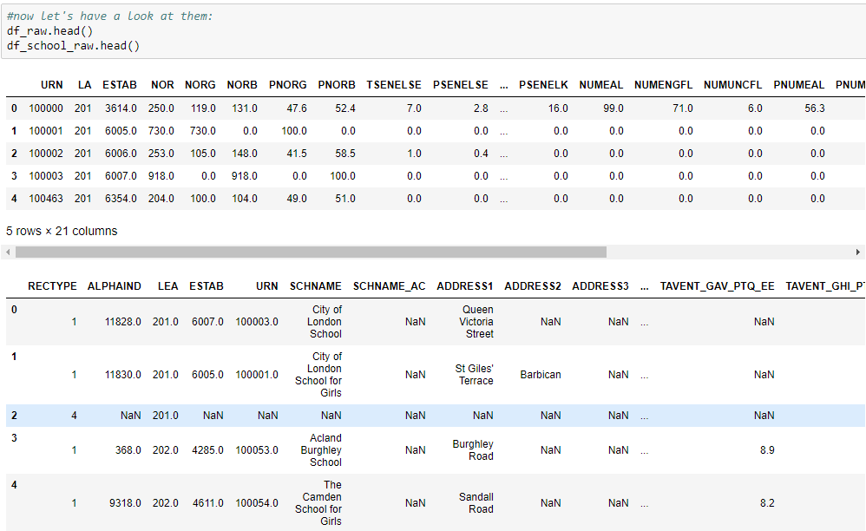
Sample Data Sets

Slide 7
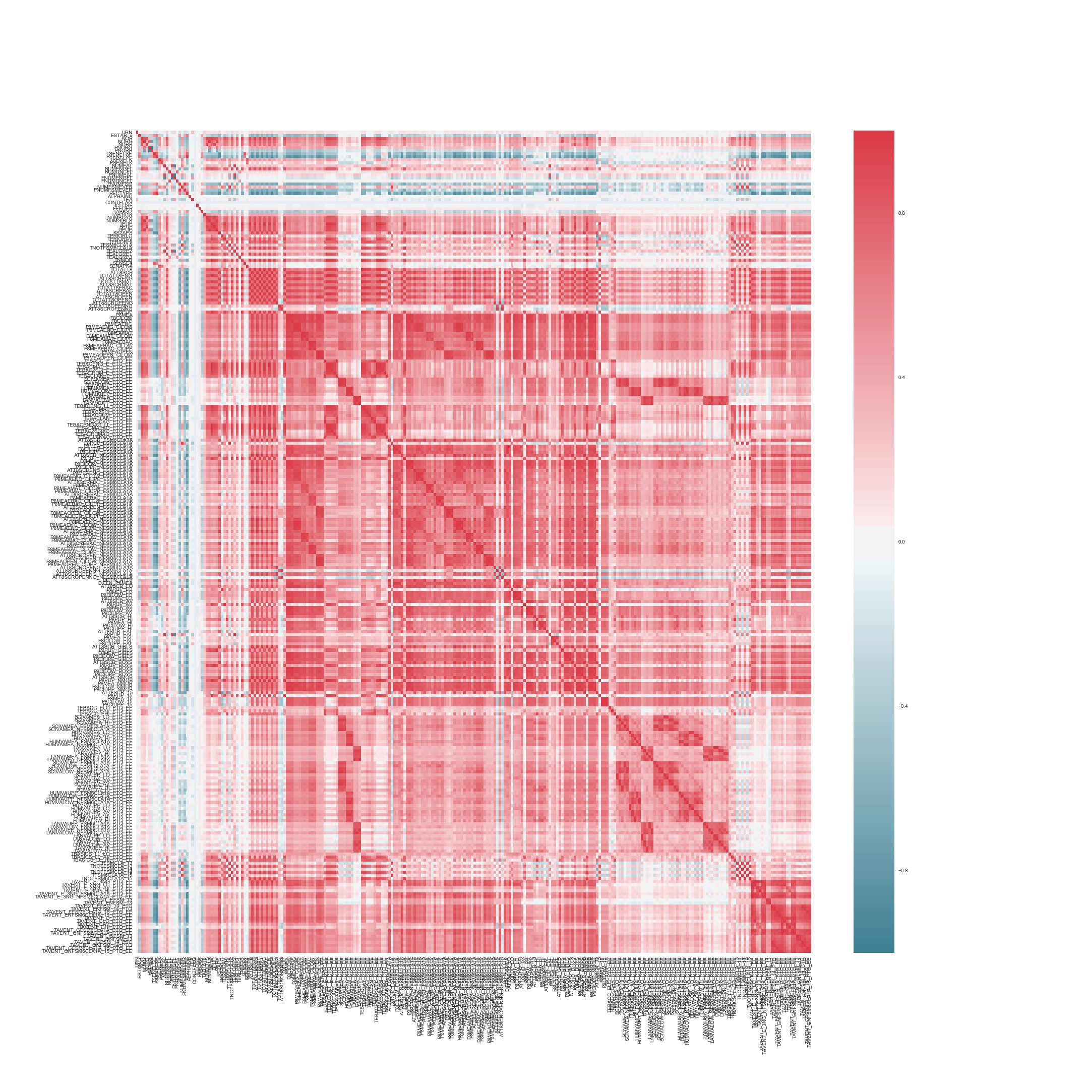
Data
Correlation Matrix:
For kS4 two datasets were used:
KS4 outcome tables:
372 features x 4017 rows
School Census Data:
21 features x 4017 rows
After cleansing the data left with:
270 features x 3506 rows
See correlation matrix
Notes:
The data used is from the Department for Education and is publicly available on the Gov.uk School statistics site [2]. The data is available in CSV file format and comes in two sections, Data & meta data. I downloaded the performance and meta data for 2015-16, KS2,KS4 & KS5. The meta data covers abbreviations for all the different data items collected. The Key Stage 4 meta file lists 372 different headings, together with descriptions, when the methodology changed, and where null values are expected. The Gov.uk website allows you to choose which data to download.
An initial look at the data produced the correlation matrix shown, Note:
Lots of correlation – lots of features break down P8 scores
Question: which ones can be dropped from any model?
Use a Random forest to do some feature selection. Looking for minimal set of features.
Initially give P8 confidence Intervals therefore drop Cis, P8 component breakdowns from dataset and see what is left.

Slide 8
Initial Modelling - Test Null Hypotheses
Null Hypothesis – there is no difference in disadvantaged v non-disadvantaged pupils P8 score.
Test – what is the distribution of P8 scores for disadvantaged v non disadvantaged pupils.
Use indicator function:
1: P8_{a}>P8_{b}
0: otherwise i.e. P8_{a}<P8_{b}
D = disadvantaged,
ND = non disadvantaged
O = overall
a= P8 ND, b = P8 D
a= P8 O, b = P8 D
Null hypothesis can be rejected.
a= P8 O, b = P8 ND
Notes:
If null hypothesis true – expect to see pretty equal 0 & 1 bars.
There are hardly any 0 observations, this means that, on the whole non disadvantaged pupils score higher on than P8 measure than disadvantaged pupil. So the distribution of scores for disadvantage pupils and distribution of scores for non-disadvantage pupils are different. Disproving the null hypothesis.

Slide 9
Initial Modelling – Feature Selection
As large, complex data set with lots of correlation. Use random forest model to highlight key features.
To drill down discard P8 component exams, confidence intervals & text features.
Add dummies for: type of school, religion of school, admission policy
Output: key features for disadvantaged and non disadvantaged pupils.
Disadvantaged | Non-disadvantaged
P8MEA_LO | P8MEA_AV
P8MEA_GIRLS | P8MEA_BOYS
P8MEA_BOYS | P8MEA_GIRLS
P8MEA_AV | P8MEA_HI
P8MEA_NFSM6CLA1A | ATT8SCR_AV
Notes:
Initially used all data but as P8 is a score the key features highlighted were the components of the score.
To drill down discard P8 component and confidence interval features and other.
Interpreting results:
The P8 measure is affected by previous KS2 performance and gender of pupils.
For disadvantaged pupils the highest factor is theP8 score for pupils with low KS2 attainment and gender.
Non disadvantage pupils the highest factor is the P8 score for pupils with average KS2 attainment, hence the rejection of the null hypothesis.
PROBLEM: ALL variables are P8 sub scores, this will be a problem if I want to predict values. Modelling will not be best fit.

Slide 10
Fit a Model: Logistic Regression
Aim: fit a predictive model taking minimum set of features, 7, and output 1 if P8 score >= average 0 otherwise.
This will be BASE CASE
7 features:
Average KS2 performance;
% with Low KS2 achievement;
Local authority;
Number on roll;
Girls or boys school (discarded mixed school)
% of pupils eligible for free school meals
The correlation matrix shows that this is quite a good feature set:
Notes:
As the prior progress

Slide 11
Modelling Results- Baseline
Odds for each feature
These results tell us that a disadvantage pupil is more likely to achieve an average P8 score if they go to a single sex school. (5x for girls, 1.5 for boys)
Interestingly having low KS2 prior performance also gives some benefit admittedly by about 1%!
Feature | Odds
KS2APS | 0.99
PTPRIORLO | 1.01
LA | 1.00
NOR | 1.00
PNUMFSM | 0.99
Gender_BOYS | 1.46
Gender_GIRLS | 5.17
Notes:
Test:
Grid search Cross validation to check for best fit.

Slide 12
Model Testing Is this the best we can do?
Precision and recall are:
The ROC curve has 60% accuracy
 | Precision | Recall
0 | 0.58 | 0.74
1 | 0.61 | 0.6
Average | 0.61 | 0.6
Can we improve by adding features. See results on next slide
Notes:
Model has 60% accuracy, 78% fitting on test data!
precison of 58% for new observations
Recall 74% for previously seen results

Slide 13
Model fitting & Testing
Fit 5 other models with different variables, including a P8 component with the following results:
Model | Features | Score | ROC | Precision | Recall | Notes
1 |  | 0.61 | 0.62 | 0.62 | 0.61 | Baseline model
3 | Baseline + Admissions policy | 0.79 | 0.62 | 0.74 | 0.67 | Issues with predicting output 1
4 | Baseline + P8Measure for KS2 low | 0.8 | 0.84 | 0.79 | 0.74 | Included P8MEA_LO
5 | Baseline + No. disadvantaged pupils | 0.6 | 0.63 | 0.63 | 0.62
6 | Baseline + faith school | 0.61 | 0.63 | 0.62 | 0.6 | Included faith school performance
7 | All features models 1-6 | 0.80 | 0.84 | 0.79 | 0.74 | Includes P8MEA_LO
See Appendix 2 for model details

Slide 14
Results
What worked?
Models predict ~60% of variability.
What didn’t work?
Feature selection-need to investigate imputation, as missing values excluded fields;
Random forest output hard to interpret.
Link function: is this right one?
High degree of correlation between features.
Got stuck in disadvantaged pupil modelling

Slide 15
CONCLUSIONS
NEXT STEPS
It is possible to model the P8 outcome for disadvantaged pupils.
Disadvantage, however it is measured, has a dire effect on attainment at KS4.
Single sex schools appear to have some impact on disadvantaged pupils attainment overall and for girls a profound impact.
Faith schools have an impact
Explore the feature space, there are over 300 features!
Open up modelling to look at P8 score for all pupils.
Other modelling methods
Other distributions to model outcome?
This is the tip of the iceberg…

Slide 16

Questions?

Slide 17
References:
References
[1] Goldstein H, Leckie G.The evolution of school league tables in England 1992-2016: ‘contextual value-added’, ‘expected progress’ and ‘progress 8’. Bristol, Bristol Working Papers in Education '#02,2016. Available from: http://www.bristol.ac.uk/education/research/publications/bristol-working-papers-in-education/[accessed 11 September 2017]
[2] Department for Education, Overall performance at the end of key stage 4 in 2016 - all pupils, available at: https://www.compare-school-performance.service.gov.uk/schools-by-type?step=phase&geographic=all&region=0&phase=secondary [accessed 11 September 2017]
[3] Department for Education, Progress 8 School Performance Measure Jan 17, available at:https://www.gov.uk/government/uploads/system/uploads/attachment_data/file/583857/Progress_8_school_performance_measure_Jan_17.pdf [accessed 17 September 2017)
[4] Stack Overflow

Slide 18
Appendix 1- Data Dictionary
Feature | Description | Location
KS2APS | Key stage 2 Average Points Score of the cohort at the end of key stage 4 | KS4
PTPRIORLO | Percentage of pupils at the end of key stage 4 with low prior attainment at the end of key stage 2 | KS4
PTPRIORAV | Percentage of pupils at the end of key stage 4 with average prior attainment at the end of key stage 2 | KS4
LA | Local Authority | KS4
NOR | Number on Roll | KS4
PNUMFSM | Percentage of pupils eligible for free school meals | Census
Gender_BOYS | Indicates whether school is single sex: boys | Dummy for EGENDER in KS4
Gender_GIRLS | Indicates whether school is single sex: girls | Dummy for EGENDER in KS4
Faith_school_Christian | Indicates whether school is a faith school : Christian | Dummy for RELDENOM in KS4
Faith_school_Jewish | Indicates whether school is a faith school : Jewish | Dummy for RELDENOM in KS4
Faith_school_Muslim | Indicates whether school is a faith school : Muslim | Dummy for RELDENOM in KS4
Faith_school_Sikh | Indicates whether school is a faith school : Sikh | Dummy for RELDENOM in KS4

Slide 19
Appendix 1 - Data Dictionary
Feature | Description | Location
AdmitPol_COMP | Admissions policy: Comprehensive | Dummy for ADMPOL in KS4
AdmitPol_MOD | Admissions policy: Modern | Dummy for ADMPOL in KS4
AdmitPol_SEL | Admissions policy: selective | Dummy for ADMPOL in KS4
P8MEA_LO | Progress 8 measure - pupils with low prior attainment | KS4
P8UP_LO | Number of pupils with low prior attainment included in Progress 8 measure | KS4
Data can be downloaded at [2]:

Slide 20
Appendix 2 Model features
Features | Model 1 | Model 2 | Model 3 | Model 4 | Model 5 | Model 6
KS2APS | X | X | X | X | X | X
PTPRIORLO | X | X | X | X | X | X
PTPRIORAV | X | X | X | X | X | X
LA | X | X | X | X | X | X
NOR | X | X | X | X | X | X
PNUMFSM | X | X | X | X | X | X
Gender_BOYS | X | X | X | X | X | X
Gender_GIRLS | X | X | X | X | X | X
Faith_school_Christian |  |  |  |  | X | X
Faith_school_Jewish |  |  |  |  | X | X
Faith_school_Muslim |  |  |  |  | X | X
Faith_school_Sikh |  |  |  |  | X | X
AdmitPol_COMP |  | X |  |  |  | X
AdmitPol_MOD |  | X |  |  |  | X
AdmitPol_SEL |  | X |  |  |  | X
P8MEA_LO |  | C | X |  |  | X
P8PUP_LO |  |  |  | X |  | X

Slide 21
Appendix 2 Odds ratios
Feature | Odds Ratio
KS2APS | 0.99
PTPRIORLO | 1.01
LA | 1.00
NOR | 1.00
PNUMFSM | 0.99
Gender_BOYS | 1.46
Gender_GIRLS | 5.17
LA
Feature | Odds Ratio
KS2APS | 1.01
PTPRIORLO | 1.01
PTPRIORAV | 0.97
LA | 1.00
NOR | 1.00
PNUMFSM | 1.00
Gender_BOYS | 1.26
Gender_GIRLS | 4.17
AdmitPol_COMP | 0.94
AdmitPol_MOD | 1.09
AdmitPol_SEL | 1
Feature | Odds Ratio
KS2APS | 1.00
PTPRIORLO | 1.02
PTPRIORAV | 0.98
LA | 1.00
NOR | 1.00
PNUMFSM | 1.00
Gender_BOYS | 1.36
Gender_GIRLS | 4.62
P8MEA_LO | 100.79
Model 1
Model 3
Model 2

Slide 22
Appendix 2 Odds Ratios
Feature | Odds Ratio
KS2APS | 1.00
PTPRIORLO | 1.05
PTPRIORAV | 0.99
LA | 1.00
NOR | 1.00
PNUMFSM | 0.99
Gender_BOYS | 1.40
Gender_GIRLS | 5.11
P8PUP_LO | 0.97
Feature | Odds Ratio
KS2APS | 1.02
PTPRIORLO | 1.02
PTPRIORAV | 0.98
LA | 1.00
NOR | 1.00
PNUMFSM | 0.99
Gender_BOYS | 1.55
Gender_GIRLS | 5.22
Faith_school_Christian | 1.47
Faith_school_Jewish | 1.12
Faith_school_Muslim | 1.66
Faith_school_Sikh | 1.09
Feature | Odds Ratio
KS2APS | 0.992
PTPRIORLO | 1.018
PTPRIORAV | 0.986
LA | 1.000
NOR | 1.001
PNUMFSM | 1.003
Gender_BOYS | 1.404
Gender_GIRLS | 4.724
P8MEA_LO | 1.180
Faith_school_Christian | 1.021
Faith_school_Jewish | 1.082
Faith_school_Muslim | 1.048
Faith_school_Sikh | 1.145
AdmitPol_COMP | 0.896
Feature | Odds Ratio
AdmitPol_SEL | 1.000
P8PUP_LO | 0.999
P8MEA_LO | 100.948
Model 6
Model 4
Model 5

